Slide 1


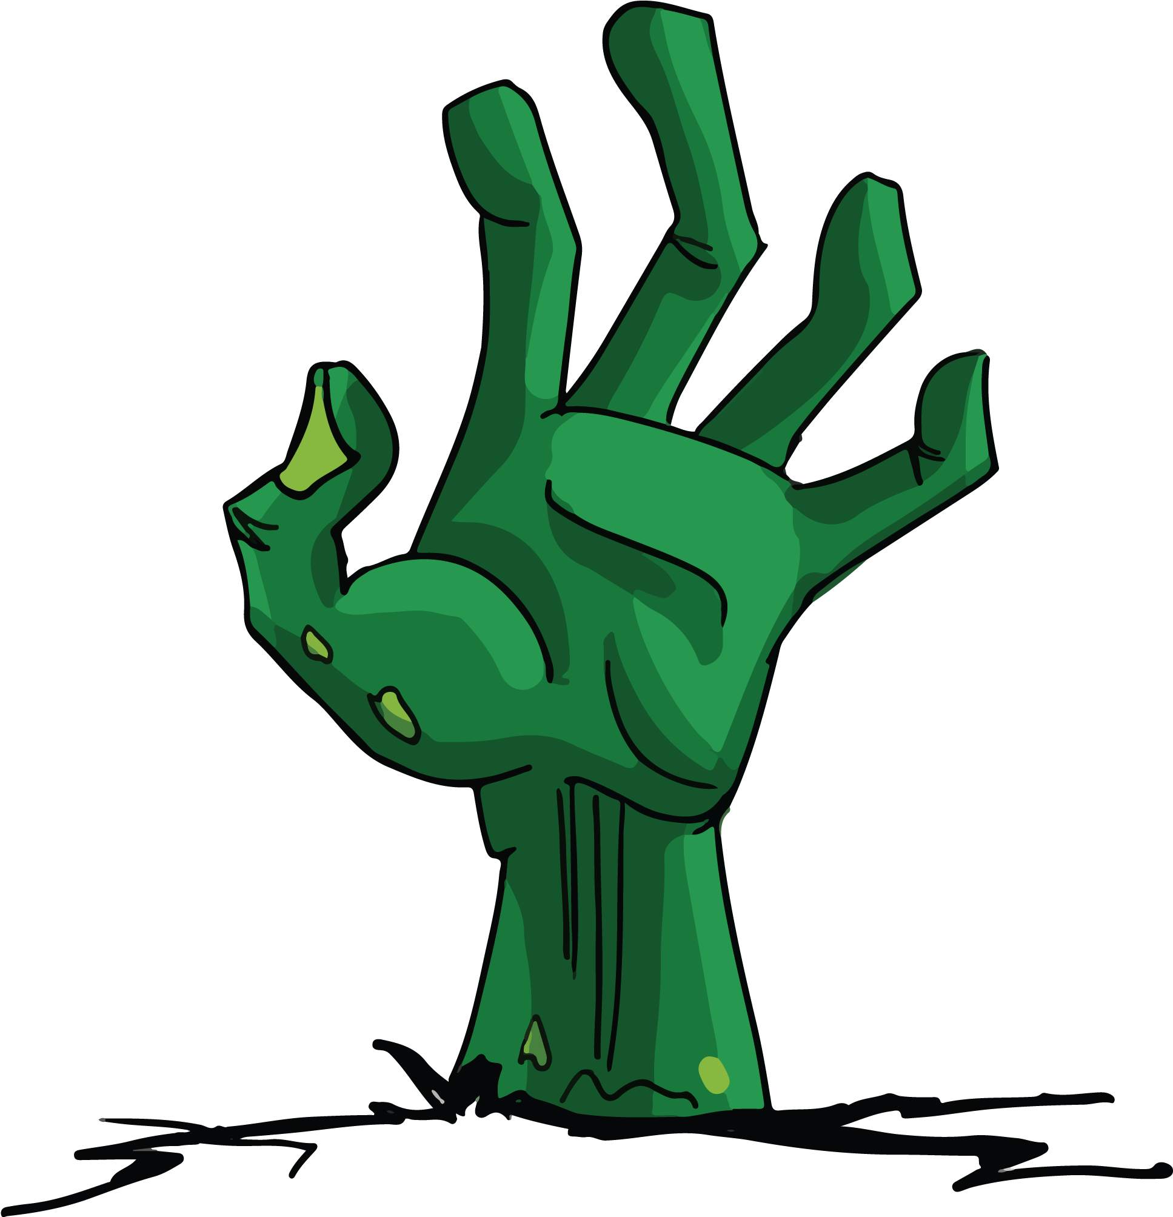
Necro Nursery
Team Abra-cadaver

Slide 2
Narrative
Started writing new World Bible iteration with changes
Ran world bible through Grammarly
Started fleshing out the Litch Character

Slide 3
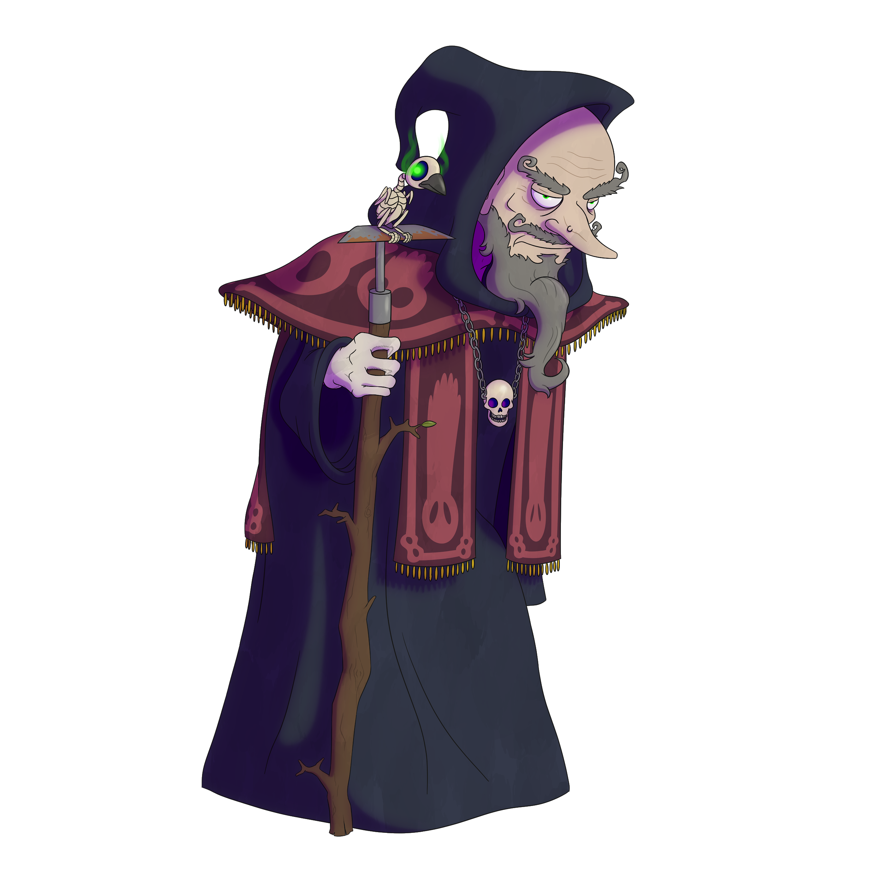
Put together roadmap for art goals for this semester

Slide 4
Programming
Unity Licensing Issues
Starting Level unlock for seeds
Mastermind minigame continues
Put together roadmap for all future programming goals

Slide 5
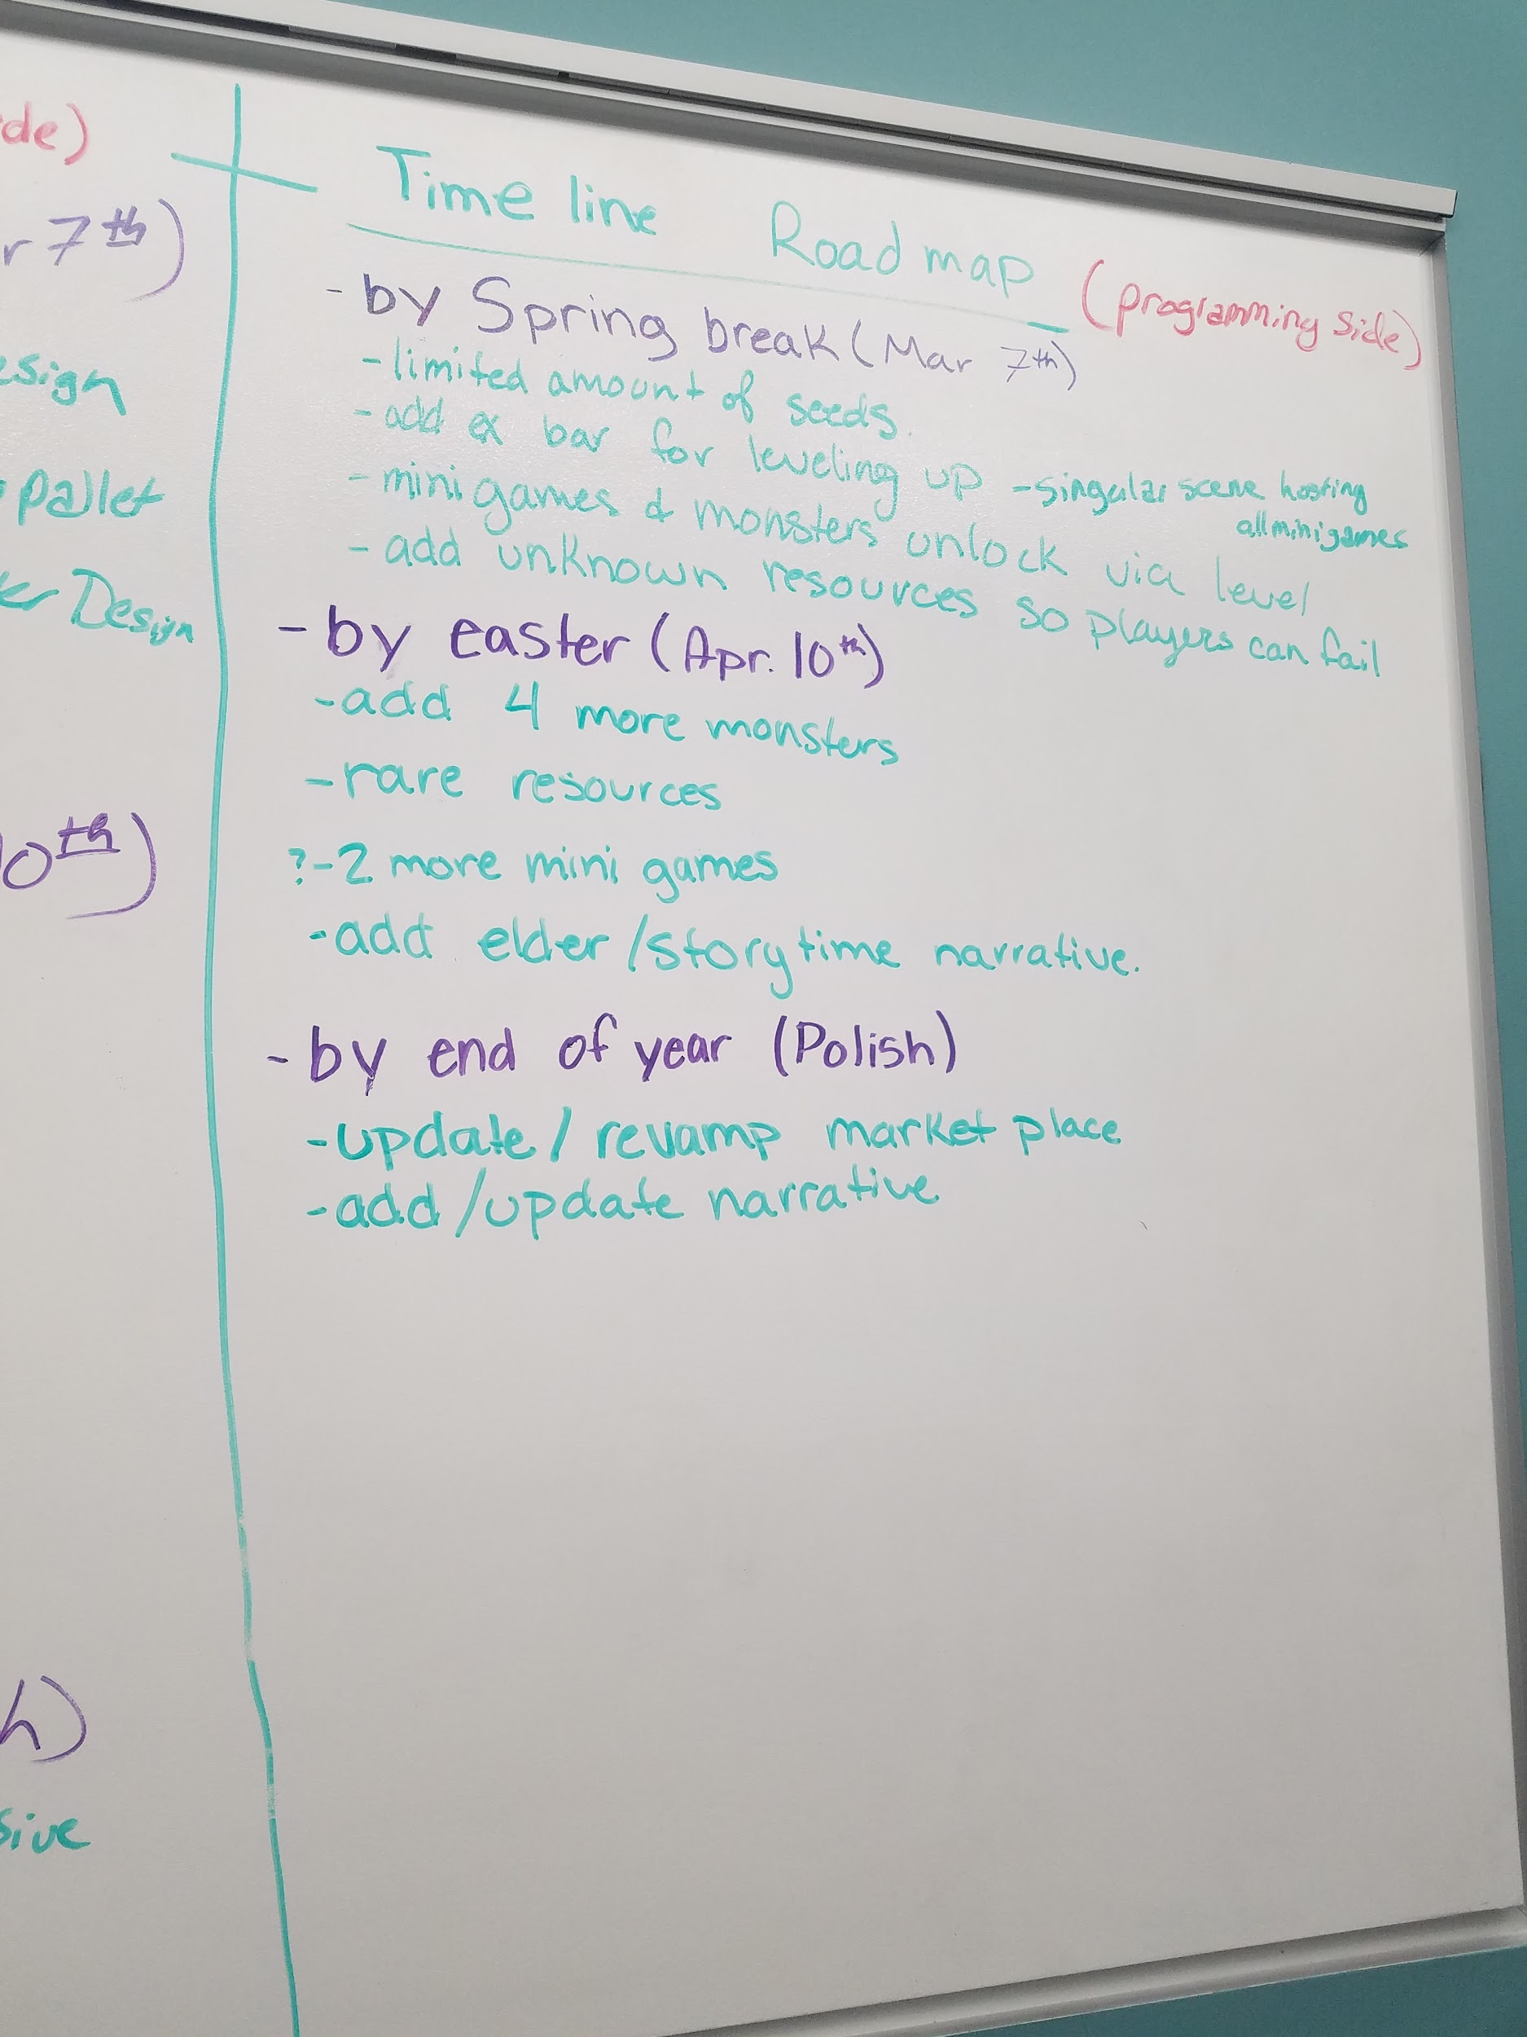
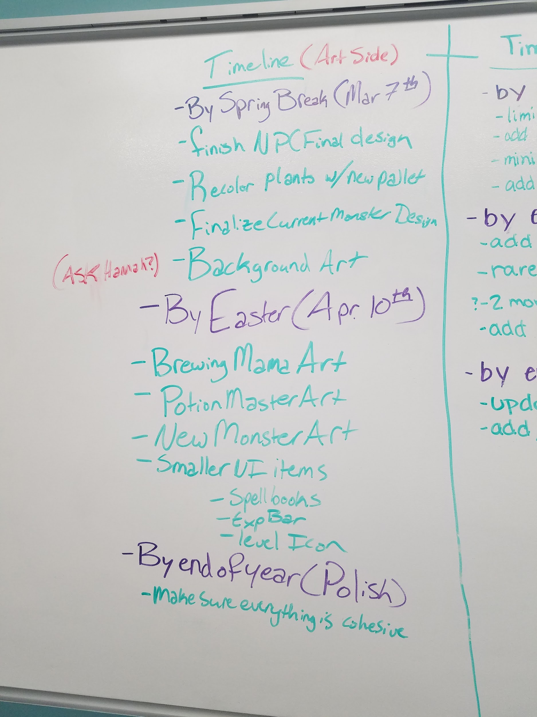
Roadmap!

Slide 6
Troubles along the way?
Getting Back into the swing of things
Unity not wanting to download correctly
Teammates Sick already

Slide 7
What we plan to do!
Discuss bringing in outside art help
Start working on feature implementation
Get more art rolled out

Slide 8
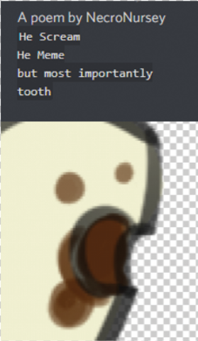
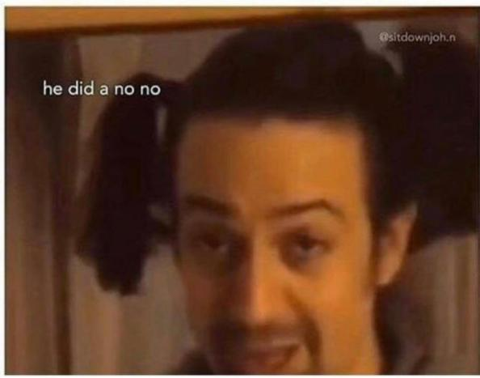
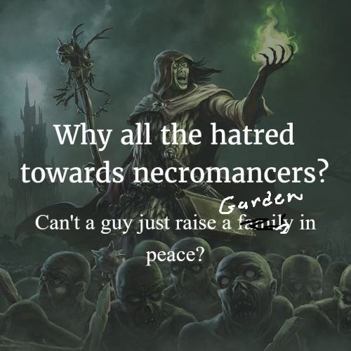

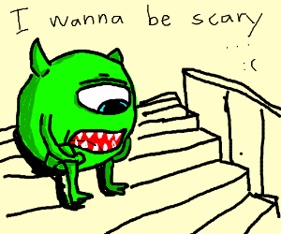
Questions?

